Slide 1
THE APPLY OPERATORS

Slide 2
APPLY OPERATORS
The APPLY operator allows you to invoke a table-valued function for each row returned by an outer table expression of a query.
The APPLY operator allows you to join two table expressions the right table expression is processed every time for each row from the left table expression.
The final result-set contains all the selected columns from the left table expression followed by all the columns of right table expression.
The APPLY operator comes in two variants :
CROSS APPLY and
OUTER APPLY.

Slide 3
Cross APPLY
The CROSS APPLY operator returns only those rows from left table expression (in its final output) if it matches with right table expression.
In other words, the right table expression returns rows for left table expression match only
For those rows for which there are no corresponding matches in right table expression, it contains NULL values in columns of right table expression.
CROSS APPLY is semantically equivalent to INNER JOIN with a implicit join condition of 1=1.

Slide 4
CROSS-APPLY VS INNER JOIN
Script #1 creates a Department table to hold information about departments. Then it creates an Employee table which hold information about the employees. Please note, each employee belongs to a department, hence the Employee table has referential integrity with the Department table.

Slide 5
First query in Script #2 selects data from Department table and uses CROSS APPLY to evaluate the Employee table for each record of the Department table.
Second query simply joins the Department table with the Employee table and all the matching records are produced.

Slide 6
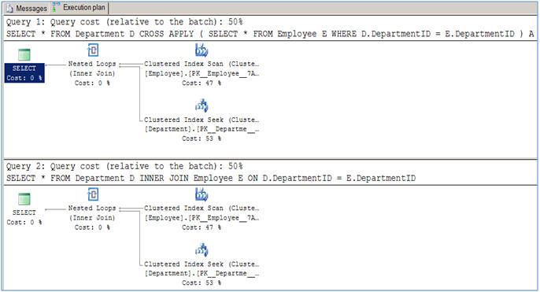
EXECUTION PLANS

Slide 7
In Script #3, I am creating a table-valued function which accepts DepartmentID as its parameter and returns all the employees who belong to this department.
The next query selects data from Department table and uses CROSS APPLY to join with the function we created.
It passes the DepartmentID for each row from the outer table expression (in our case Department table) and evaluates the function for each row similar to a correlated subquery.

Slide 8
CROSS APPLY can increase the performance of the query
sample table

Slide 9
Outer apply
The OUTER APPLY operator returns all the rows from left table expression irrespective of its match with the right table expression.
For those rows for which there are no corresponding matches in right table expression, it contains NULL values in columns of right table expression.
OUTER APPLY is semantically equivalent to LEFT OUTER JOIN.

Slide 10
The first query in Script #4 selects data from Department table and uses OUTER APPLY to evaluate the Employee table for each record of the Department table.
For those rows for which there is not a match in Employee table, those rows contains NULL values as you can see in case of row 5 and 6.
The second query simply uses a LEFT OUTER JOIN between the Department table and the Employee table. As expected the query returns all rows from Department table even for those rows for which there is no match in the Employee table.
OUTER APPLY returns non-correlated data as well, placing NULLs into the missing columns.

Slide 11
SUMMARY
APPLY operator is required when you have to use table-valued function in the query , and it can also be used with an inline SELECT statements.

Slide 12
Thank you

